Slide 1


Slide 2

Java OOP and Data Structures with Introduction to Secure Coding Dr. Ziping Liu
Chapter 10 Nested Types: Inner and Anonymous Classes

Slide 3
https://he.kendallhunt.com/product/java-oop-and-data-structures-introduction-secure-coding
Chapter 10 Nested Types: Inner and Anonymous Classes

Slide 4

Chapter Outlines
Defining and using nested classes
Defining and using local classes
Defining and using anonymous classes
Creating and applying lambda expressions
Leveraging the observer design pattern

Slide 5
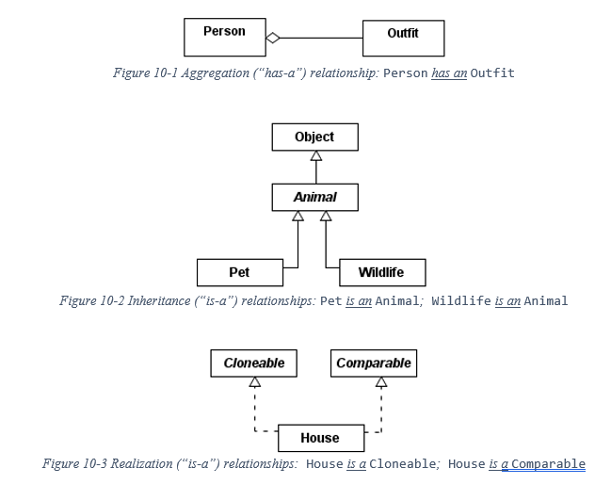
10.1 Nested Classes
Aggregation, inheritance, and realization are “linear” relationships between two classes

Slide 6
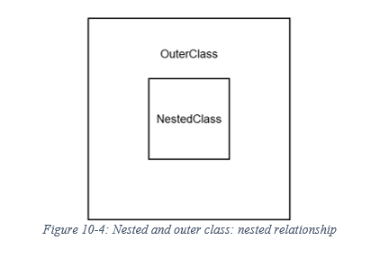
10.1 Nested Classes
nested classes follow a nested relationship

Slide 7
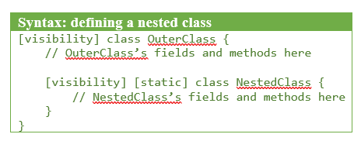
10.1 Nested Classes

Slide 8
10.1 Nested Classes
What is a Nested Class?
The full name of the nested class is OuterClass.NestedClass
two major types: non-static or static
Non-static nested classes are referred to as “inner classes.”
must be associated with (i.e. created by using) an instance of the outer class
can access all the outer class’s fields and methods, even if they are private
The outer class can also access all the inner class’s fields and methods, including private ones
cannot define any static members
static nested classes: the static keyword
can only access static members of the outer class
belong to the entire outer class type (rather than one instance of the outer class)
may define static members

Slide 9
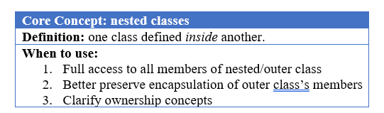
10.1 Nested Classes
What is a Nested Class?

Slide 10
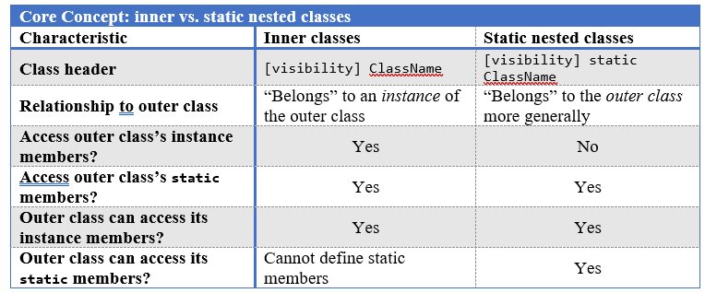
10.1 Nested Classes
What is a Nested Class?

Slide 11
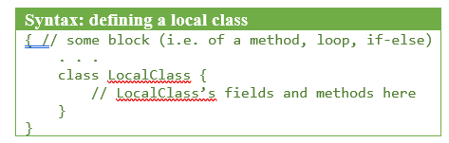
10.2 Local Classes
define classes within another block, creating a local class

Slide 12
10.2 Local Classes
What is a Local Class?
a special type of (non-static) inner class
belong to an instance of the outer class
cannot define any static members, except static constants (i.e. static final <type>)
Allow to create a local class within a static method/block, and that local class—nested within a static block—would only be access static members of the outer class
Doesn’t allow the entire local class to be static, such as static class LocalClass { . . . }
define a private static class instead

Slide 13
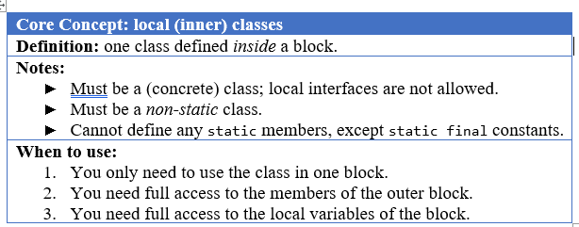
10.2 Local Classes
What is a Local Class?
“Local interfaces” are not allowed
a local class is only valid within the scope of its enclosing block

Slide 14


Slide 15


Slide 16
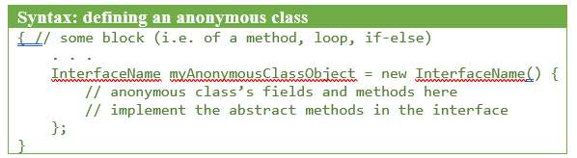
10.3 Anonymous Classes
unnamed local classes

Slide 17
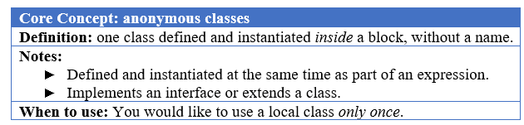
10.3 Anonymous Classes
What is an Anonymous Class?
The anonymous class is defined and instantiated at the same time
Unlike a local class, which is declared according to the normal class headers and rules, an anonymous class is part of an expression

Slide 18
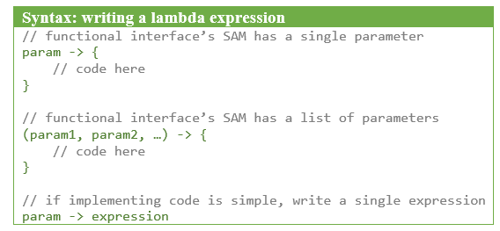
10.4 Lambda Expressions
An interface with a single abstract method (SAM)—but potentially numerous default methods—is called a functional interface
We can create anonymous classes from a functional interface. Java provides an even more concise option: lambda expressions.
A lambda expression looks like a method definition, but it serves to create an instance of certain type.

Slide 19
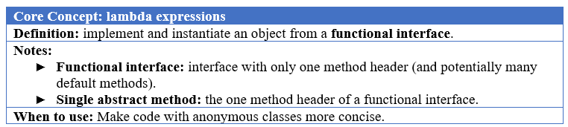
10.4 Lambda Expressions
What is a Lambda Expression?
composed of three main parts
match the parameter or list of parameters in parentheses from the single abstract method of the functional interface. If the SAM takes in a single parameter, we can omit the parentheses
a right-pointing arrow
code block

Slide 20
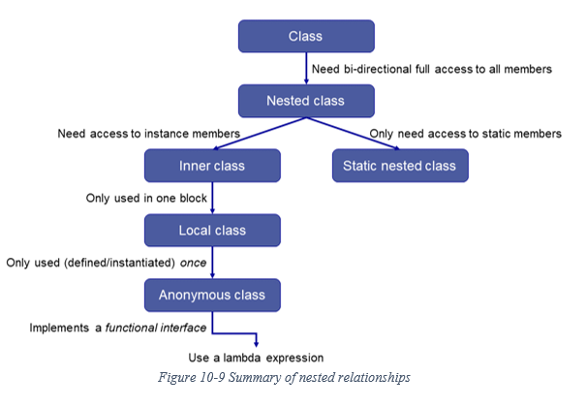
Summary of nested relationships

Slide 21
Which National Park is it?
Answer: Grand Teton National Park

